Slide 1

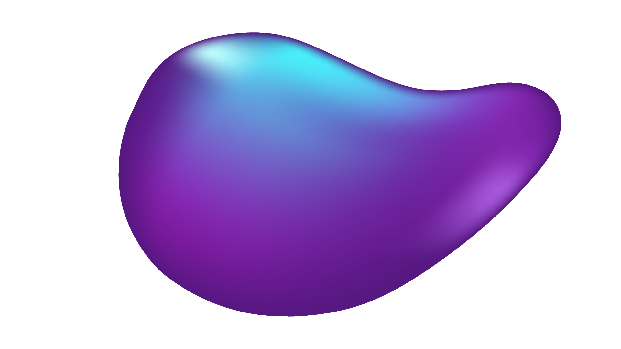
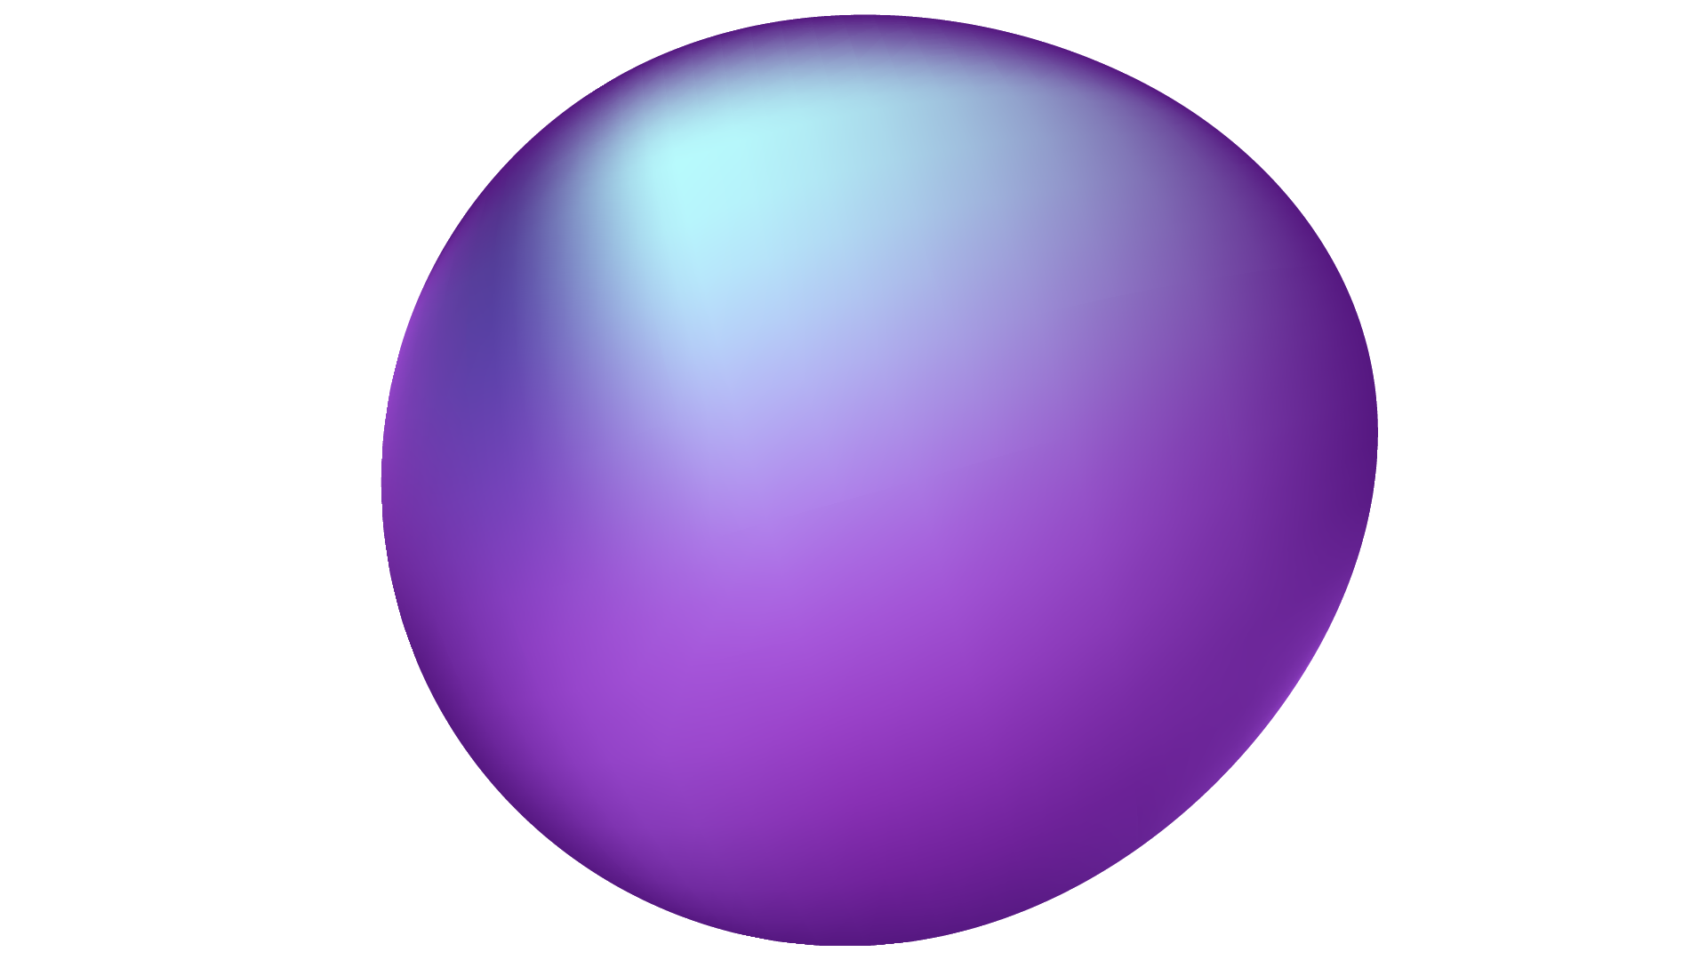
An Overarching YOLO Performance Analysis
Groups: A, F, G, I

Slide 2
TABLE OF CONTENTS
01
02
03
04
05
ABOUT THE PROJECT
You can describe the topic of the section here
MAJOR REQUIREMENTS
You can describe the topic of the section here
PROJECT GOALS
You can describe the topic of the section here
SNEAK PEEK
You can describe the topic of the section here
PROJECT STAGES
You can describe the topic of the section here

Slide 3
CONTENTS OF THIS TEMPLATE
You can delete this slide when you’re done editing the presentation
FONTS | To view this template correctly in PowerPoint, download and install the fonts we used
USED AND ALTERNATIVE RESOURCES | An assortment of graphic resources that are suitable for use in this presentation
THANKS SLIDE | You must keep it so that proper credits for our design are given
COLORS | All the colors used in this presentation
ICONS AND INFOGRAPHIC RESOURCES | These can be used in the template, and their size and color can be edited
EDITABLE PRESENTATION THEME | You can edit the master slides easily. For more info, click here
For more info: SLIDESGO | BLOG | FAQs
You can visit our sister projects: FREEPIK | FLATICON | STORYSET | WEPIK | VIDEVO

Slide 4
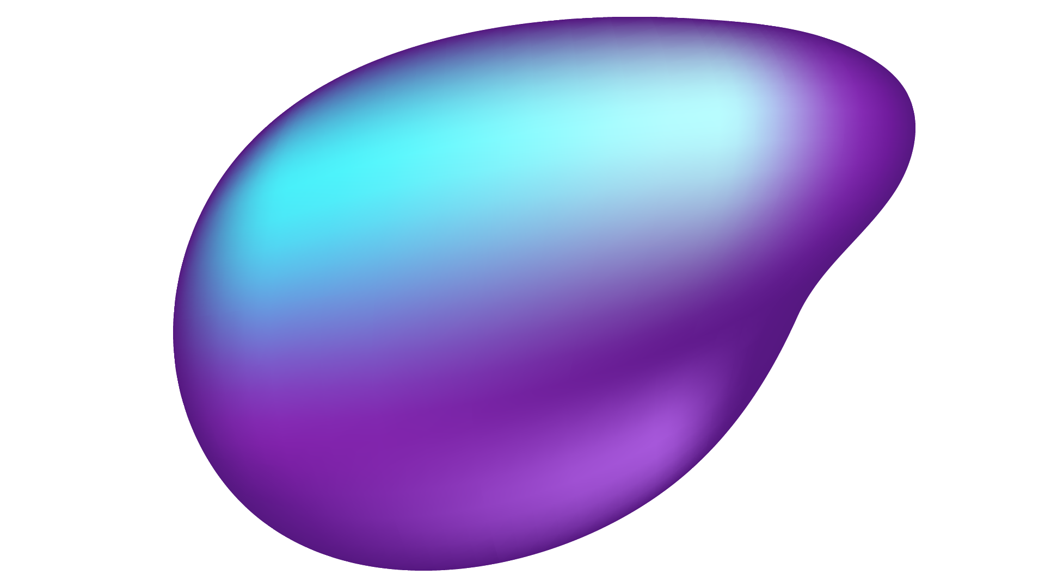

ABSTRACT
Object Detection is Critical for Robotics, Surveillance, and Autonomous Systems
This Study Benchmarks YOLOv5 and YOLOv8 on CPUs, GPUs, and Edge Devices
Objective: Provide Insights into Trade-Offs for Hardware and Model Selection
Key Results:
YOLOv8 Excels in Speed & Accuracy, Especially on Edge Devices
Discrete GPUs are the Most Efficient, up to 27.23x Better than CPUs

Slide 5
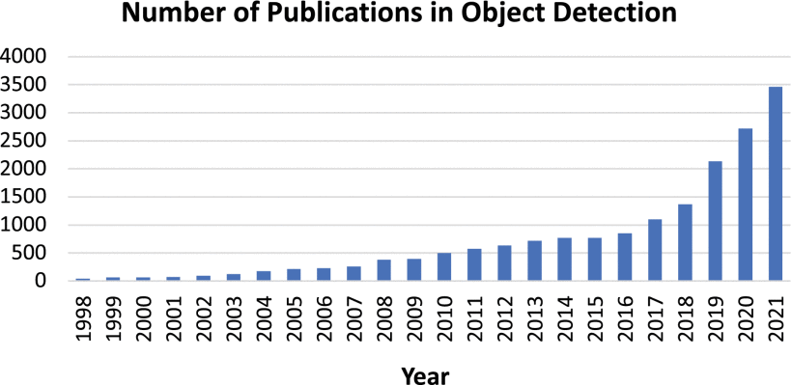
Introduction
Object Detection: Identifying Objects in Images or Video
Importance: Applications in Robotics,, Autonomous Systems, Surveillance
Research Question: How do YOLOv5 & v8 Perform on Different Hardware Platforms

Slide 6
HARDWARE CONFIGURATIONS
1
2
3
HIGH-
PERFORMANCE SYSTEMS
INTEGRATED GRAPHICS
EDGE DEVICES
System 1: Intel i7-12700KF, NVIDIA RTX 4080
System 2: AMD Ryzen 9 5950X, AMD Radeon RX 6900 XT
Intel i5-11400H (UHD Graphics), AMD Ryzen 5 5600G (Vega 7 Graphics)
NVIDIA Jetson Orin Nano, NVIDIA Jetson Nano

Slide 7

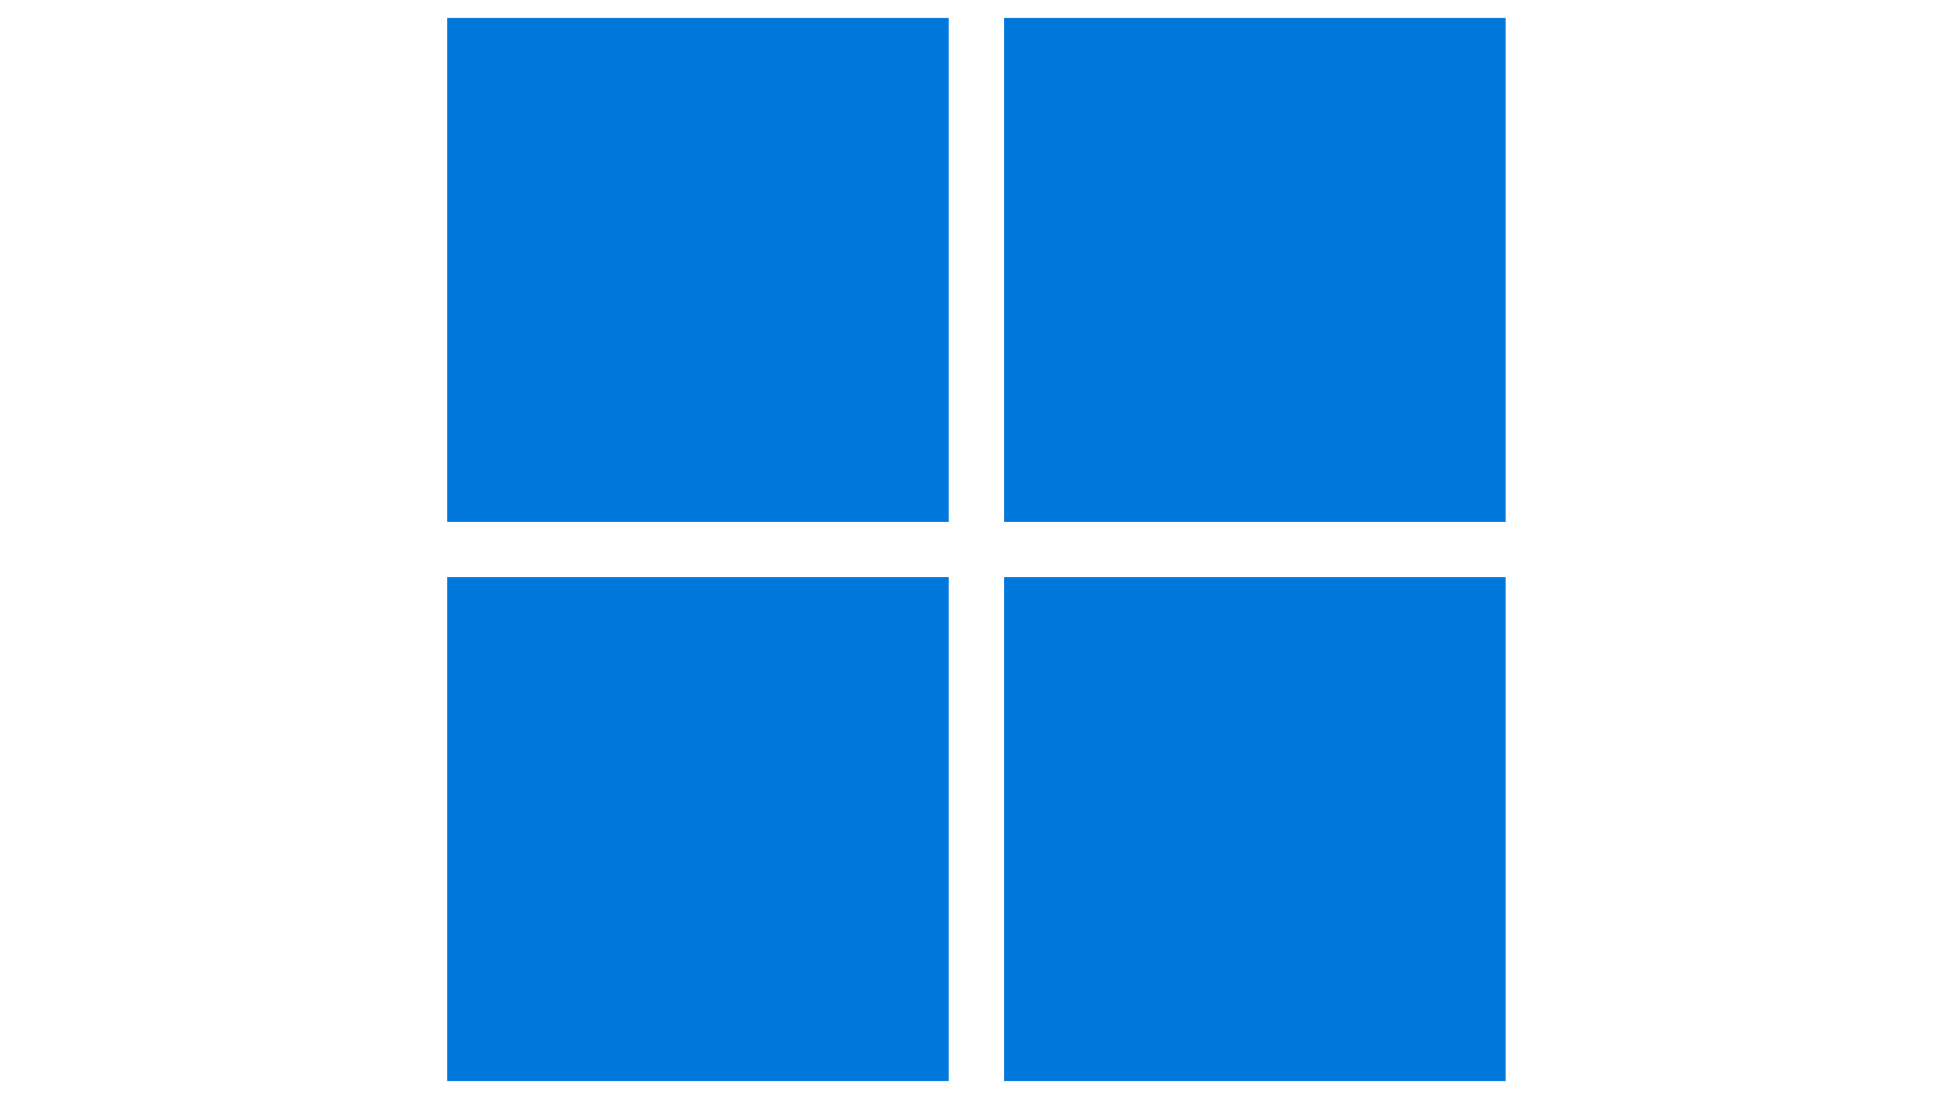

SOFTWARE FRAMEWORKS
Operating Systems:
Windows 10
Ubuntu 20.04 LTS
Frameworks:
YOLOv5 (Exported to ONNX for Compatibility)
YOLOv8 (Native Framework, PyTorch 1.12.0)
OpenCV and Roboflow for Dataset Handling
Monitoring Tools: HWiNFO64, psutil

Slide 8
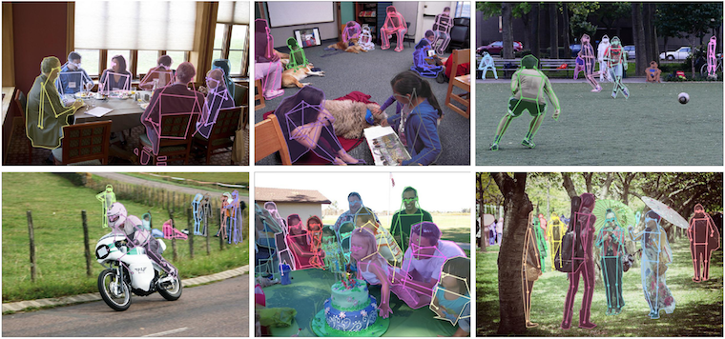
METHODOLOGY
Dataset: COCO 2017 Val (128 Images, Batch Size 16)
Metrics:
Throughput: Images/Sec
Inference Time: Processing Time/Image
Power Efficiency: Watts per Image/Sec
Memory Utilization: CPU & GPU Memory Usage
Process:
GPU Testing First to Avoid Interference
Metrics Tracked During Each Test

Slide 9
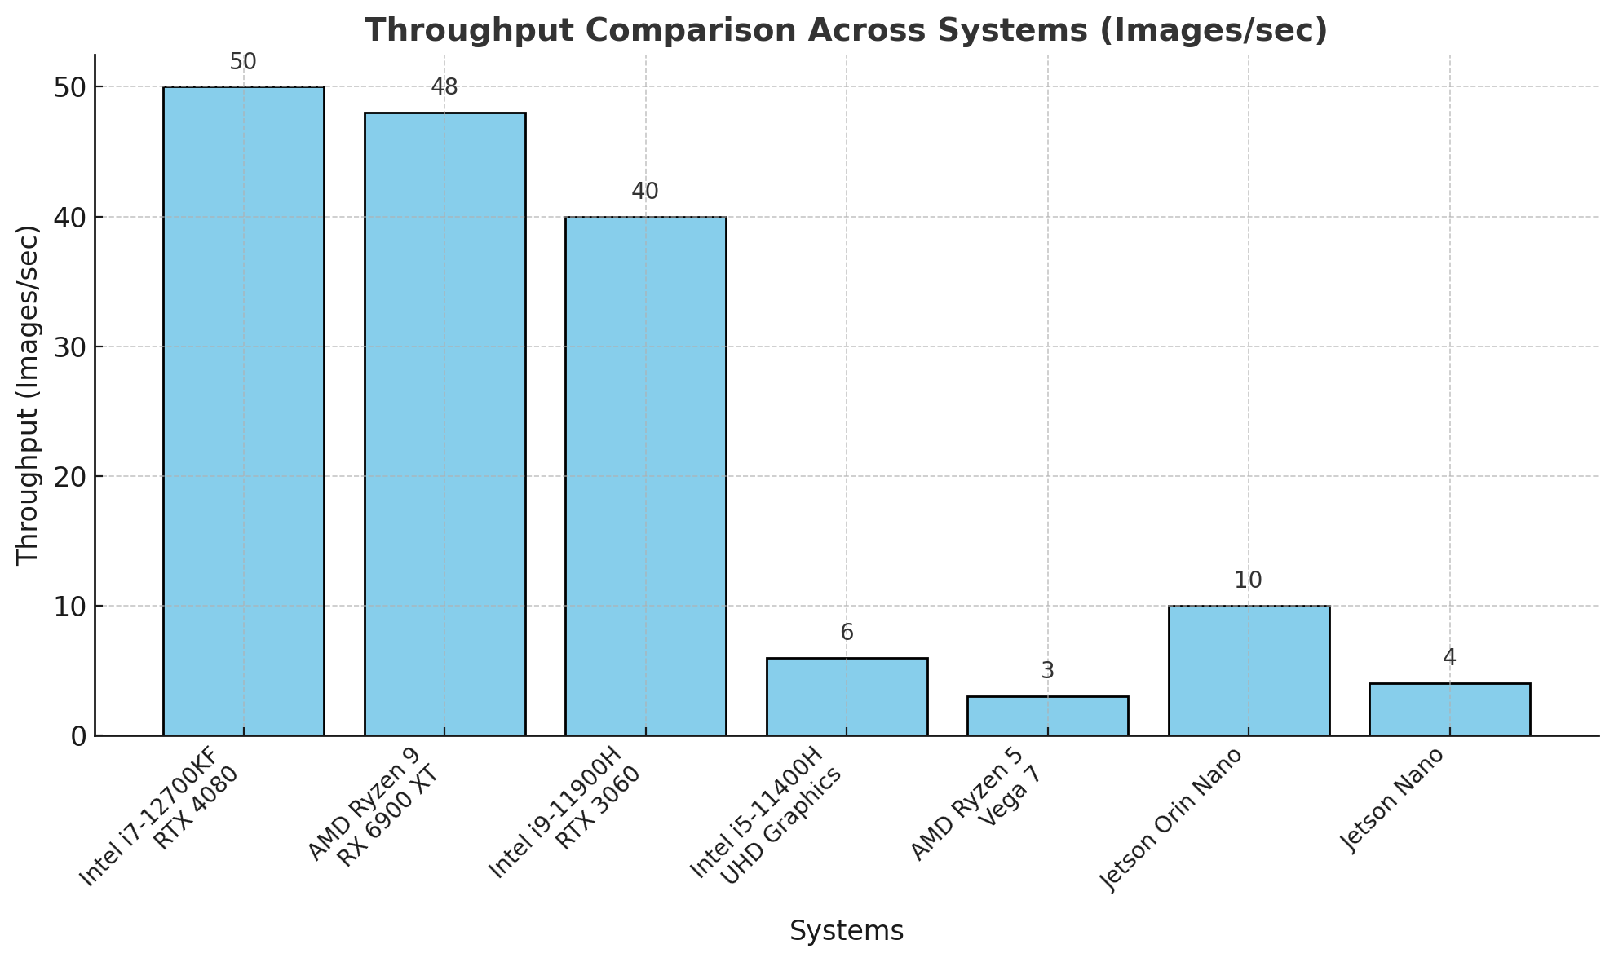
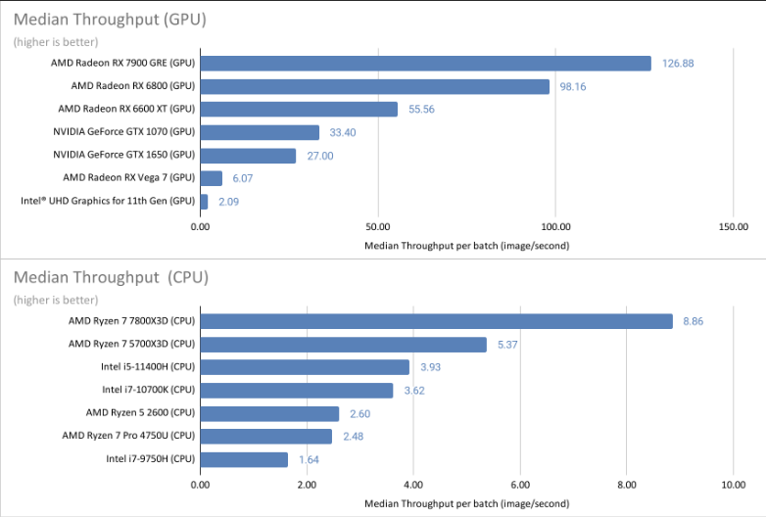
Results - Throughput
Observation:
GPUs Outperform CPUs Significantly
RTX4080 (System 1) Achieves over 50 Images/Sec
Jetson Nano (<5 Images/Sec) Limited by Processing Power

Slide 10
Results - Power Efficiency
System | Power Efficiency (Watts Per Image)
Intel i7-12700KF + RTX 4080 | 1.5
AMD Ryzen 9 + RX 6900 XT | 1.8
Intel i9-11900H + RTX 3060 | 2.2
Intel i5-11400H + UHD Graphics | 6.0
AMD Ryzen 5 + Vega 7 | 8.0
Jetson Orin Nano | 4.0
Observation:
Discrete GPUs Most Efficient (1.5-2W/Image/Sec)
Jetson Orin Nano is Efficient for Edge Devices (~4 W/Image/Sec)
Integrated GPUs Consume More Power for Lower Throughput

Slide 11
YOLOv5 vs YOLOv8 Comparison
Metric | YOLOv5 | YOLOv8
Throughput | Lower (Robust in Varying Environments) | Higher (Suited for Real-Time Applications)
Inference Time | Higher (Slower Processing) | Lower (Faster Processing)
Detection Confidence | Higher at Longer Distances | Slightly Lower at Longer Distances
Power Efficiency | Moderate (Less Efficient) | Higher (More Efficient on Edge Devices)

Slide 12
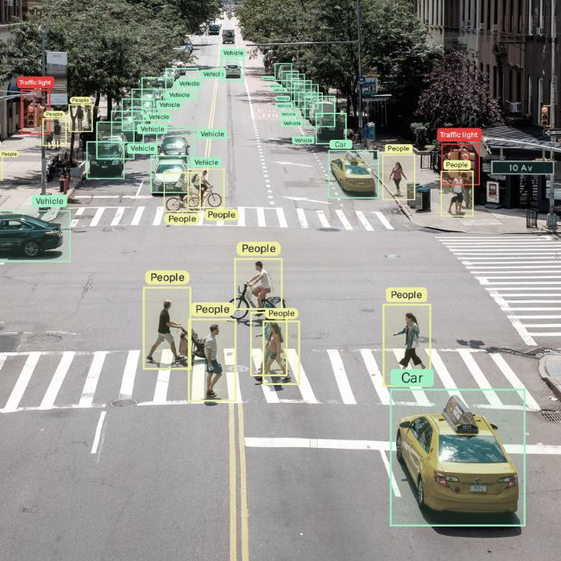
CONCLUSION
Discrete GPUs Excel in Performance, Suitable for Large Scale Tasks
YOLOv8 is Optimal for Real-Time Detection and Edge Devices
YOLOv5 Remains Reliable for Scenarios Requiring Robust Confidence
Key Insight: Model & Hardware Selection Depend on use Case Priorities

Slide 13
FUTURE WORK
GOAL 1
Explore Further Optimizations for YOLO Models on Edge Devices
GOAL 2
Investigate Reducing Memory utilization for Real-Time Tasks
GOAL 3
Expand Benchmarking to Other Detection Models

